Slide 1
Classification: Basic Concepts and Decision Trees

Slide 2
Classification: Definition
Given a collection of records (training set )
Each record contains a set of attributes, one of the attributes is the class.
Find a model for class attribute as a function of the values of other attributes.
Goal: previously unseen records should be assigned a class as accurately as possible.
A test set is used to determine the accuracy of the model. Usually, the given data set is divided into training and test sets, with training set used to build the model and test set used to validate it.

Slide 3
Illustrating Classification Task

Slide 4
Classification Techniques
Rule-based Methods
Naïve Bayes and Bayesian Belief Networks
Decision Tree based Methods
Neural Networks
Support Vector Machines
etc…

Slide 5
Example of a Decision Tree
categorical
categorical
continuous
class
Splitting Attributes
Refund
Yes
No
NO
MarSt
Single, Divorced
Married
TaxInc
NO
< 80K
> 80K
NO
YES
Training Data
Model: Decision Tree

Slide 6
Decision Tree Classification Task
Decision Tree

Slide 7
Apply Model to Test Data
Test Data
Start from the root of tree.
Refund
Yes
No
NO
MarSt
Single, Divorced
Married
TaxInc
NO
< 80K
> 80K
NO
YES

Slide 8
Apply Model to Test Data
Test Data
Refund
Yes
No
NO
MarSt
Single, Divorced
Married
TaxInc
NO
< 80K
> 80K
NO
YES

Slide 9
Apply Model to Test Data
Test Data
Refund
Yes
No
NO
MarSt
Single, Divorced
Married
TaxInc
NO
< 80K
> 80K
NO
YES

Slide 10
Apply Model to Test Data
Test Data
Refund
Yes
No
NO
MarSt
Single, Divorced
Married
TaxInc
NO
< 80K
> 80K
NO
YES

Slide 11
Apply Model to Test Data
Test Data
Refund
Yes
No
NO
MarSt
Single, Divorced
Married
TaxInc
NO
< 80K
> 80K
NO
YES

Slide 12
Apply Model to Test Data
Test Data
Refund
Yes
No
NO
MarSt
Single, Divorced
Married
Assign Cheat to “No”
TaxInc
NO
< 80K
> 80K
NO
YES

Slide 13
What are some business applications of classification?

Slide 14
How to build Decision Tree
Greedy strategy.
Split the records based on an attribute test that optimizes certain criterion.
Issues
Determine how to split the records
How to specify the attribute test condition?
How to determine the best split?
Determine when to stop splitting

Slide 15
How to build Decision Tree
Greedy strategy.
Split the records based on an attribute test that optimizes certain criterion.
Issues
Determine how to split the records
How to specify the attribute test condition?
How to determine the best split?
Determine when to stop splitting

Slide 16
How to Specify Test Condition?
Depends on attribute types
Nominal
Ordinal
Continuous
Depends on number of ways to split
2-way split
Multi-way split

Slide 17
Splitting Based on Continuous Attributes
Different ways of handling
Discretization to form an ordinal categorical attribute
Static – discretize once at the beginning
Dynamic – ranges can be found by equal interval bucketing, equal frequency bucketing (percentiles), or clustering.
Binary Decision: (A < v) or (A ≥ v)
consider all possible splits and find the best cut
can be more compute intensive

Slide 18
Splitting Based on Nominal Attributes
Multi-way split: Use as many partitions as distinct values.
Binary split: Divides values into two subsets. Need to find optimal partitioning.
CarType
Family
Luxury
Sports
CarType
OR
CarType
{Sports, Luxury}
{Family, Luxury}
{Family}
{Sports}

Slide 19
Splitting Based on Ordinal Attributes
Multi-way split: Use as many partitions as distinct values.
Binary split: Divides values into two subsets. Need to find optimal partitioning.
What about this split?
Size
Small
Large
Medium
Size
Size
{Small, Medium}
OR
{Medium, Large}
{Large}
{Small}
Size
{Small, Large}
{Medium}

Slide 20
Splitting Based on Continuous Attributes

Slide 21
Tree Induction
Greedy strategy.
Split the records based on an attribute test that optimizes certain criterion.
Issues
Determine how to split the records
How to specify the attribute test condition?
How to determine the best split?
Determine when to stop splitting

Slide 22
How to determine the Best Split
Before Splitting: 10 records of class 0, 10 records of class 1
Which test condition is the best?

Slide 23
How to determine the Best Split
Greedy approach:
Nodes with homogeneous class distribution are preferred
Need a measure of node impurity:
Non-homogeneous,
High degree of impurity
Homogeneous,
Low degree of impurity

Slide 24
Measures of Node Impurity
Gini Index
Entropy

Slide 25
Measure of Impurity: GINI
Gini Index for a given node t :
(NOTE: p( j | t) is the relative frequency of class j at node t).
Maximum (1 - 1/n_{c}) when records are equally distributed among all classes, implying least interesting information
Minimum (0.0) when all records belong to one class, implying most interesting information
Notes:
1 – ( (1/6)^2 + (5/6)^2) ) for the second split

Slide 26
Splitting Based on GINI
When a node p is split into k partitions (children), the quality of split is computed as,
where, n_{i} = number of records at child i,
n = number of records at node p.

Slide 27
Alternative Splitting Criteria based on INFO
Entropy at a given node t:
(NOTE: p( j | t) is the relative frequency of class j at node t).
Measures homogeneity of a node.
Maximum (log n_{c}) when records are equally distributed among all classes implying least information
Minimum (0.0) when all records belong to one class, implying most information
Entropy based computations are similar to the GINI index computations

Slide 28
Splitting Based on INFO
Information Gain:
Parent Node, p is split into k partitions;
n_{i} is number of records in partition i
Measures Reduction in Entropy achieved because of the split. Choose the split that achieves most reduction (maximizes GAIN)
Disadvantage: Tends to prefer splits that result in large number of partitions, each being small but pure.

Slide 29
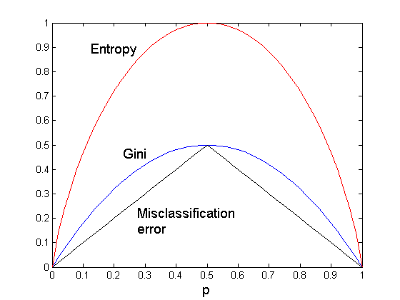
Comparison among Splitting Criteria
For a 2-class problem:

Slide 30
Tree Induction
Greedy strategy.
Split the records based on an attribute test that optimizes certain criterion.
Issues
Determine how to split the records
How to specify the attribute test condition?
How to determine the best split?
Determine when to stop splitting

Slide 31
Stopping Criteria for Tree Induction
Stop expanding a node when all the records belong to the same class
Stop expanding a node when all the records have similar attribute values

Slide 32
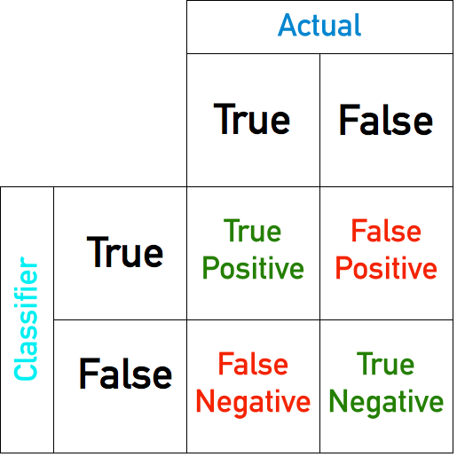
Model Performance

Slide 33
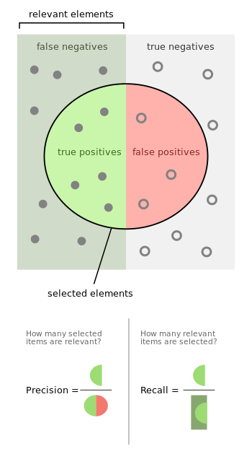
Model Performance

Slide 34

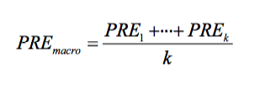
Model Performance: Multiple Categories

Slide 35
ROC curve comparison
A good test:
A poor test:
100%
100%
True Positive Rate
True Positive Rate
0%
0%
0%
100%
0%
100%
False Positive Rate
False Positive Rate

Slide 36
ROC curve extremes
Best Test:
Worst test:
100%
100%
True Positive Rate
True Positive Rate
0%
0%
0%
100%
0%
False Positive Rate
100%
False Positive Rate
The distributions don’t overlap at all
The distributions overlap completely

Slide 37
Decision Tree Based Classification
Advantages:
Inexpensive to construct
Extremely fast at classifying unknown records
Easy to interpret for small-sized trees
Accuracy is comparable to other classification techniques for many simple data sets

Slide 38
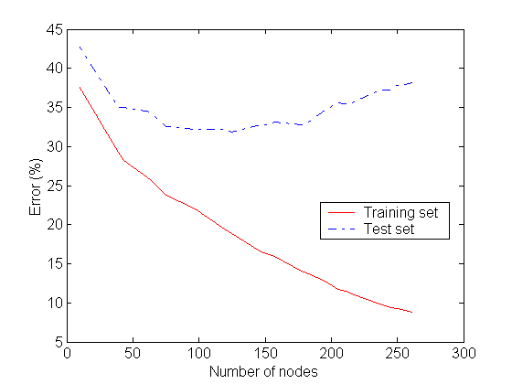
Underfitting and Overfitting
Overfitting
Underfitting: when model is too simple, both training and test errors are large

Slide 39
Notes on Overfitting
Overfitting results in decision trees that are more complex than necessary
Training error no longer provides a good estimate of how well the tree will perform on previously unseen records

Slide 40
How to Address Overfitting
Pre-Pruning (Early Stopping Rule)
Stop the algorithm before it becomes a fully-grown tree
Typical stopping conditions for a node:
Stop if all instances belong to the same class
Stop if all the attribute values are the same
More restrictive conditions:
Stop if number of instances is less than some user-specified threshold
Stop if class distribution of instances are independent of the available features (e.g., using χ ² test)
Stop if expanding the current node does not improve impurity measures (e.g., Gini or information gain).

Slide 41
How to Address Overfitting
Pre-Pruning (Early Stopping Rule) in R
maxdepth: maximum depth of a tree.
minsplit: minimum number of records that must exist in a node for a split to happen or be attempted.
minbucket: minimum number of records that can be present in a Terminal node.

Slide 42
How to Address Overfitting
Post-pruning
Grow decision tree to its entirety
Trim the nodes of the decision tree in a bottom-up fashion

Slide 43
How to Address Overfitting
Post-pruning
Minimum error. The tree is pruned back to the point where the cross-validated error is a minimum. Cross-validation is the process of building a tree with most of the data and then using the remaining part of the data to test the accuracy of the decision tree.
Smallest tree. Technically the pruning creates a decision tree with cross-validation error within 1 standard error of the minimum error. The smaller tree is more intelligible at the cost of a small increase in error.

Slide 44
Occam’s Razor
”If two theories explain the facts equally well, then the simpler theory is to be preferred”
Arguments in favor:
Fewer short hypotheses than long hypotheses
A short hypothesis that fits the data is unlikely to be a coincidence
A long hypothesis that fits the data might be a coincidence
Arguments opposed:
There are many ways to define small sets of hypotheses

